Slide 1

WELCOME TO
OWASP ASVS

Slide 2
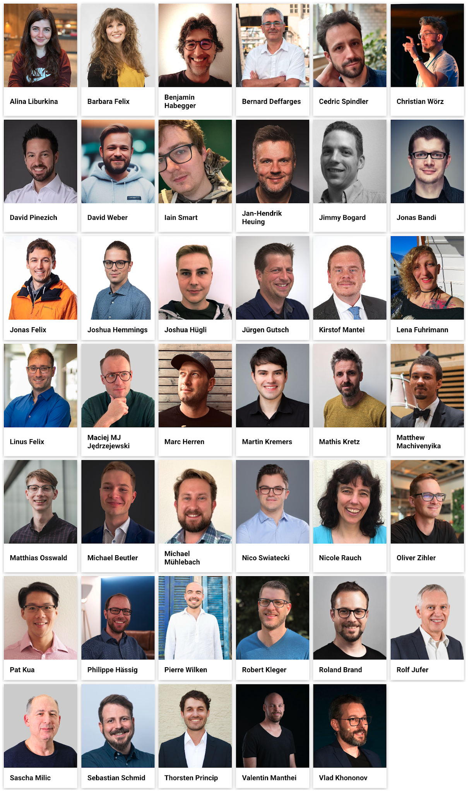
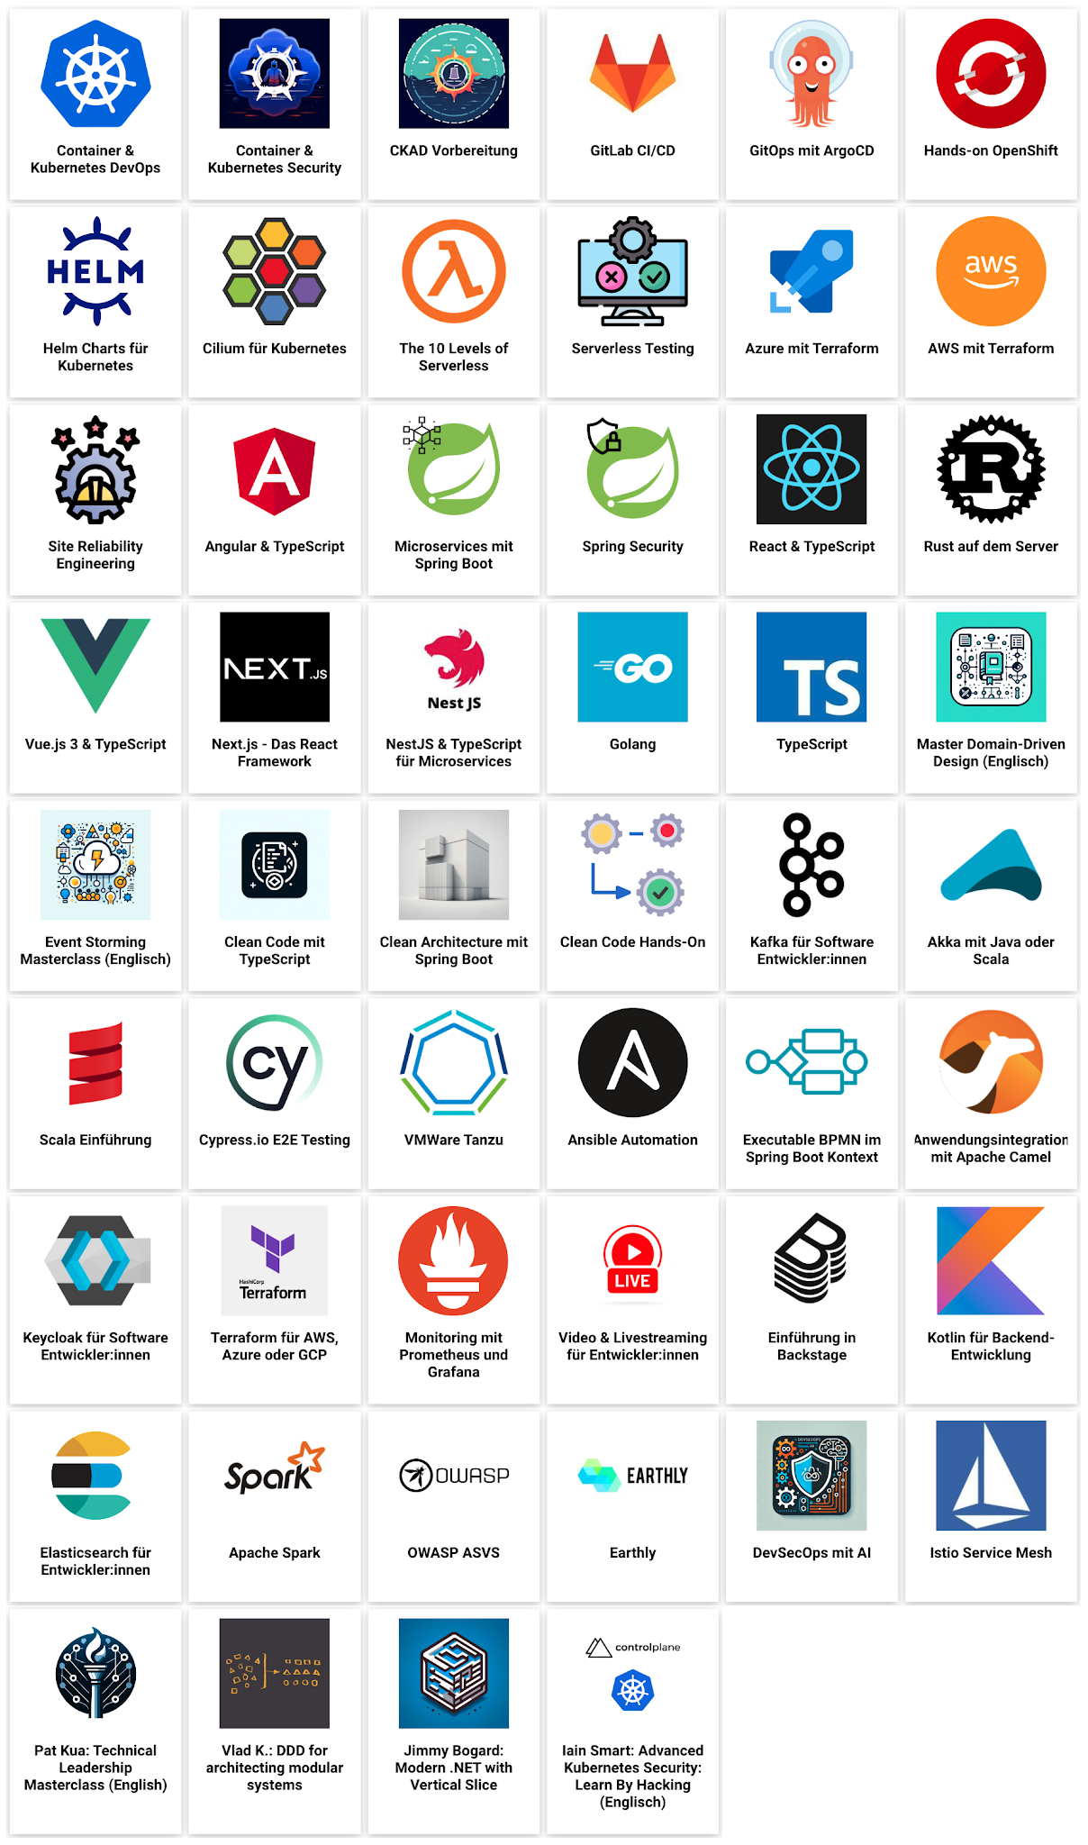
TEAM & TOPICS
Notes:
IMPORTANT:
Always Update the images by:
Right click => Replace Image => By URL => https://static.letsboot.ch/letsboot-team.png
Right click => Replace Image => By URL => https://static.letsboot.ch/letsboot-topics.png

Slide 3
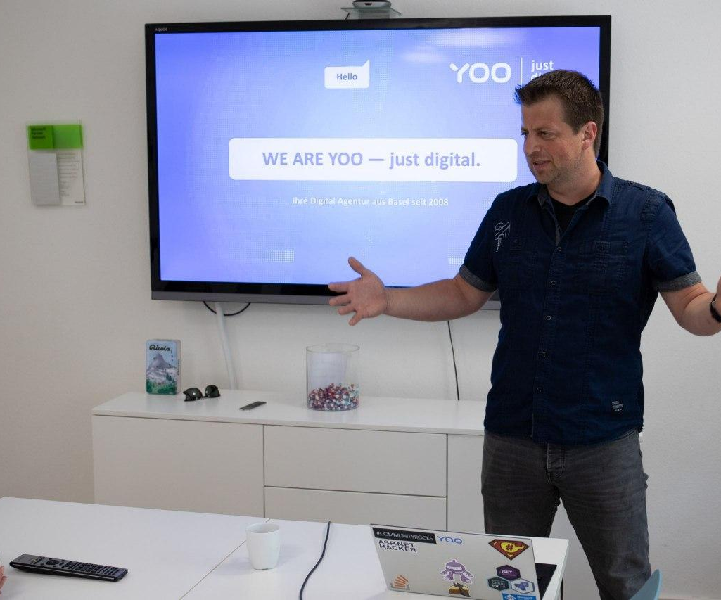
Software Engineer at YOO AG in Basel
This is me:
Software Engineer, AppSec Responsible & QA Ambassador @ YOO AG
.NET addicted web developer
Microsoft MVP for 10 years
Author and Blogger
https://asp.net-hacker.rocks
https://www.linkedin.com/in/juergengutsch/
https://twitter.com/sharpcms
https://yoo.digital/

Slide 4
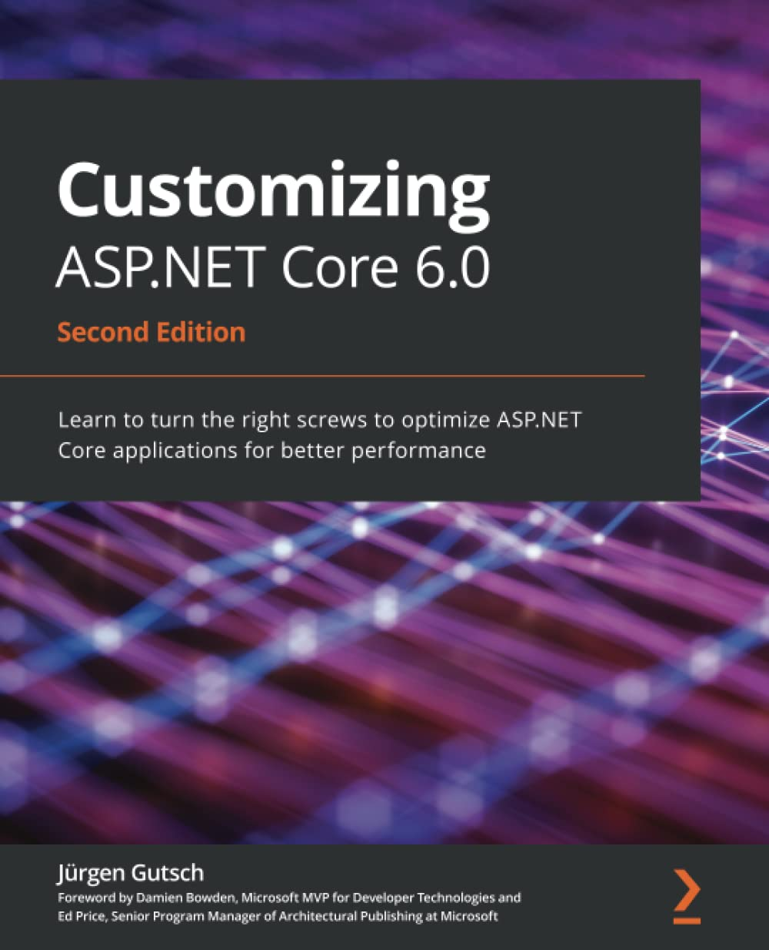
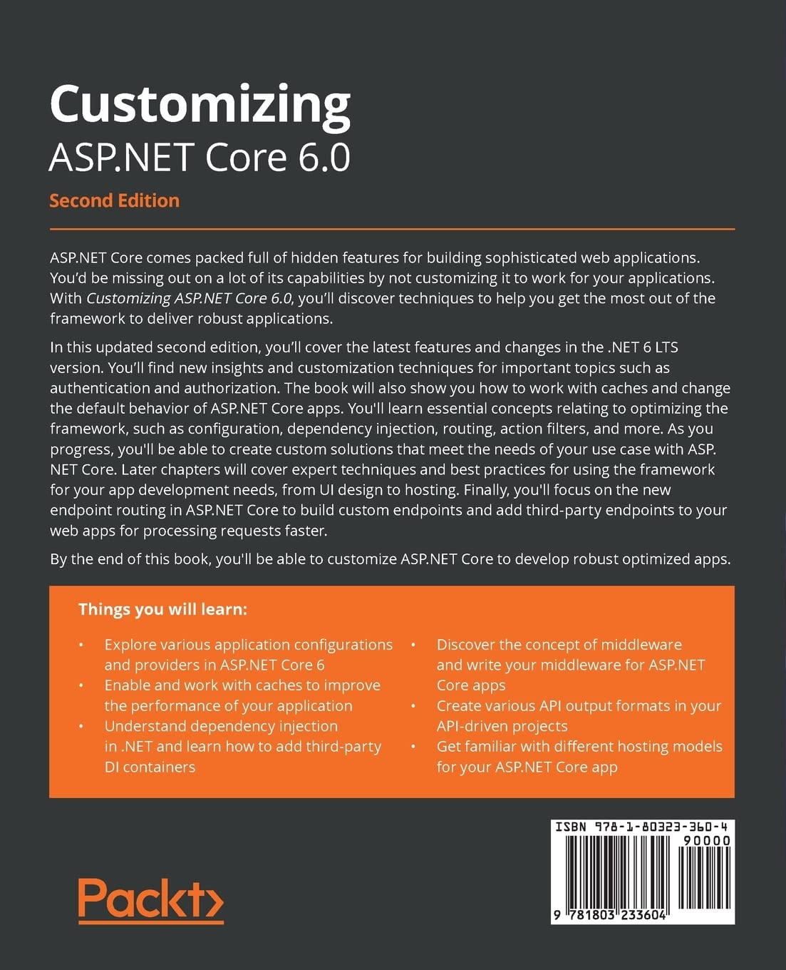
My Book
Customizing ASP.NET Core
Available on Packt and Amazon
https://packt.link/a/9781803233604

Slide 5
About YOO
Services
As a leading digital agency based in Basel, we develop inspiring digital solutions.
We support our clients in the digital transformation process with a holistic approach to people, technology and business.
Everyday we implement exceptional and value-adding solutions – pragmatic and always for the customers' entrepreneurial success.
We are YOO – just digital.
Consulting & Strategy
Planning & Concept Phase
We know what really matters when it comes to digital strategies and transformation processes. We help with the strategic planning and its implementation.
From a thorough analysis via defined requests up to marketable prototypes which were tested with the target group.
Digital Transformation
Business Processes
Digital Strategy
Cloud Services
Business-Analysis & User Research
Requirements Engineering
Service- & Experience-Design
Visual- & Interaction-Design
User & Usability Tests
Figures
Facts
Design & Implementation
Maintenance & Support
2008 Foundation
Digital agency, based in Basel, Switzerland, founded by Laurin Stoll.
Agile & flexible
Structured working methods with transparent processes
We put our heart and soul into our digital solutions. By developing in-house we have full control over the quality and can offer interesting job opportunitites.
During the whole life cycle we accompany your solution and support you also after go-live with first class support.
53+ Employees
Strong interdisciplinary team with 51 pros and two trainees
Budget & Timing
Realistic and fair calculation of budget & time
Corporate Websites
Intranet & Extranet Platforms
Business Productivity Applications (Business Software)
Web & Mobile Apps
Promotional Games & Microsites
Development & Operations (DevOps)
Service Level Agreement (SLA)
Content Maintenance & Trainings
1.527+ Projects
A wealth of experience through diverse projects of all sizes for different industries.
Local & global
Our solutions, developed in Switzerland, are in use around the world.

Slide 6
Agenda Day 1
What is ASVS?
Introducing ASVS
OWASP ASVS vs. OWASP Top 10
Comparing and usage
Levels of Security
Which level for which type of application?
ASVS in the project lifecycle
Deep dive
Creating standards.
ASVS as a security blueprint
Creating checklists.
Threat Model for an existing online shop
Risk analysis.
group work.

Slide 7
Agenda Day 2
Pentest against an existing online shop
group work.
Triage pentest findings.
group work.
Fixing pentest findings
Theory only (find out what to do)
group work.
Retesting the application
group work.
Validate the fixes.
Pentest reports
Show your work.
Open Discussion, Q&A

Slide 8
Administrative information
Schedule proposal:
8:30 Start
10:00 Coffee Break
12:00 – 13:00 Lunch
14:30 Coffee Break
16:30 End

Slide 9
Administrative information
Most of the workshop will be group work.
After a half day of theoretical introduction, the rest of the workshop will be exercises in groups.
Please group yourself in small groups of at max four people.
Every exercise ends with a short presentation of the results, and I – as the customer - might ask questions to the group.
Ensure every member of the group is contributing to the group work.
I’d prefer every member is doing at least one presentation.

Slide 10
Administrative information
Every group can decide how to work, how to prepare and how to present the results.
Feel free to use analogue or digital technology or a combination of it.
Also the presentation can be done by one presenter or by all members of the group.

Slide 11
Administrative information
Infrastructure:
Everyone of you has an account on the gitlab repository of letsboot.ch
There you will find some learning material as well as the demo application we work with
You can start the demo application within gitlab
A URL to connect the demo will be displayed as soon the application is started

Slide 12
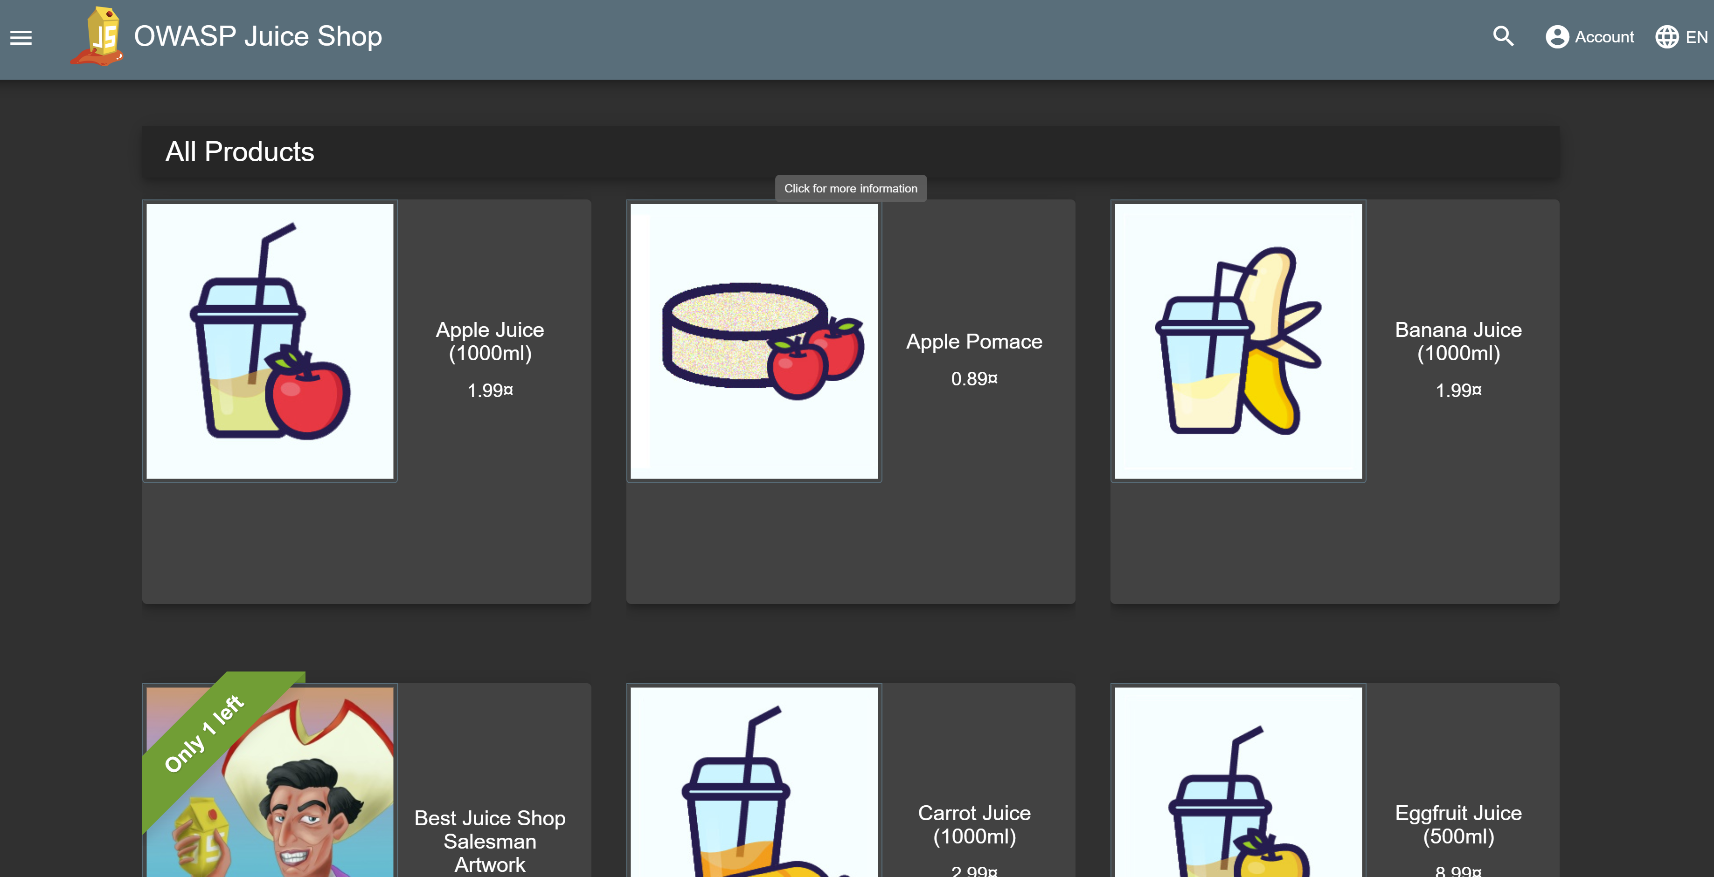
JuiceShop
This is the application we will work with.
We don’t look at sources or technical implementation
Initial credentials
Username: admin@juice-sh.op
Password: admin123

Slide 13
What is ASVS?

Slide 14
OWASP in a nutshell
“The Open Worldwide Application Security Project (OWASP) is a nonprofit foundation that works to improve the security of software.”
“… an open community dedicated to enabling organizations to conceive, develop, acquire, operate, and maintain applications that can be trusted. All of our projects, tools, documents, forums, and chapters are free and open to anyone interested in improving application security. The OWASP Foundation launched on December 1st, 2001, becoming incorporated as a United States non-profit charity on April 21, 2004.”
https://owasp.org/
OWAS is driven by independent security experts

Slide 15
OWASP Top 10
“The OWASP Top 10 is a standard awareness document for developers and web application security. It represents a broad consensus about the most critical security risks to web applications.” https://owasp.org/www-project-top-ten/
Shows the Top 10 security risks
Every developer and security expert should know
Last update 2021

Slide 16
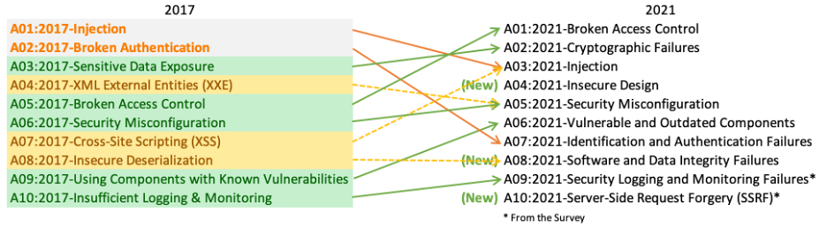
OWASP Top 10
https://owasp.org/www-project-top-ten/

Slide 17
What is ASVS?
Application Security Verification Standard
ASVS is a catalog of security measurements to make web applications more secure
It adopts the most of the proprietary security standards
It covers the entire software lifecycle
It is a kind of a blueprint to secure your web application

Slide 18
ASVS Fakts
Application Security Verification Standard
14 Chapters
3 Levels
Current Version: 4.x
A separate MASVS for mobile is available and a version for IoT (currently as an appendix in ASVS) will come in the future.

Slide 19
ASVS vs. Top 10
ASVS
Security catalog
A security standard
Covers almost all
To develop against
To pentest against
Top 10
List of top security risks
A quick overview
Covers the top 10 risks
To keep in mind

Slide 20
Digg into ASVS
Demo: Looking at the resources and PDFs

Slide 21
Levels of security

Slide 22
Levels of security
ASVS is structured in 14 chapter and 3 levels of security
Level 1 is the basic security level and a must for all applications
Level 2 for all applications that handle sensitive information
Level 3 for applications of critical infrastructure or ones that handle critical information

Slide 23
Levels of security
Level 1
Level 1 is focusing on hackers that using “simple and low effort techniques”
Level 2
Level 2 is focusing “skilled and motivated attackers”
Level 3
Level 3 is focusing on “professional and highly motivated hackers”

Slide 24
Levels of security - Criticality
How to decide what level to use?
How would you define levels of criticality?

Slide 25
Levels of security - Criticality
Basic
Name, email addresses
Sensitive
Misuse of those data can harm people or organizations
Postal addresses, birthdates, other personal information, shopping cards, order histories, etc.
Critical
Misuse can bankrupt or even kill people or organization
Health information, banking data, insurance data, top-secret, government or military information, power plant or grid information

Slide 26
ASVS in the project lifecycle

Slide 27
ASVS in the project live cycle
ASVS covers the entire software project life cycle
Starting at sales and requirements engineering to know what level of security need to be implemented
Requirements engineering, UX and design to cover security specs
Project management and specifications to cover security in general
Software engineering to implement security to the application
DevSecOps to secure development, deployment and hosting
Testing to pentest the application against security standards

Slide 28
ASVS in Sales
Try to know the potential customer or the potential project
Try to figure out the criticality of the customer
What type of customer: banking, insurance, military, government, shop, website
Classify the data to handle
sensitive, critical
Higher levels might increase the costs to the customer
Try to argue security personnel to protect your facility is expensive, secure applications that protect your digital environment might be as well
Security is not given by default. Level 1 should, though.

Slide 29
ASVS in UX and RE
Cover security specific UX, like setup and usage of MFA, logins, registrations, etc.
Cover security specific requirements
All specs should also cover security

Slide 30
ASVS and Project Management
Keep in mind that
Security takes time and might be complicated in some cases.
Security can become more complex than estimated initially.
Security is always hard to estimate and hard to plan

Slide 31
ASVS and DevOps
Security + DevOps = DevSecOps
Make the entire development, build and deployment live cycle secure
Track and check all dependencies against vulnerabilities
Add static code analysis to find possible risks in the code
Enforce PRs, and builds and green tests before merging to a main branch
Deploy automatically to reduce errors (CD)
Restrict access to build and release pipelines, if possible
Restrict access to deployment environments
Prefer managed identities over personal accounts to connect services

Slide 32
ASVS and Testing
Pentest should be a part of the test strategy.
Plan an complete pentest against ASVS before releasing the first time and before every major release.
Pentest new features against ASVS.
If you need an external certified pentester, do a pentest against ASVS before to avoid too much findings.
Never ever ship an untested piece of software.

Slide 33
Interaktiv ASVS and Development
Always keep security in mind.
OWASP Top 10
Develop against the ASVS Checklists
Ask for security specific requirements, if a spec is missing information.
Look at security issues in pull request.
Keep yourself uptodate about the latest standards.
Book trainings, attend conferences, read books and blogs

Slide 34
ASVS as a security blueprint

Slide 35
ASVS as a security blueprint
ASVS comes as PDF and many other formats
You can download JSON to create some automation out of it.
The best way to work with it is to create checklists out of it.
Every new project can use this list and work against them

Slide 36
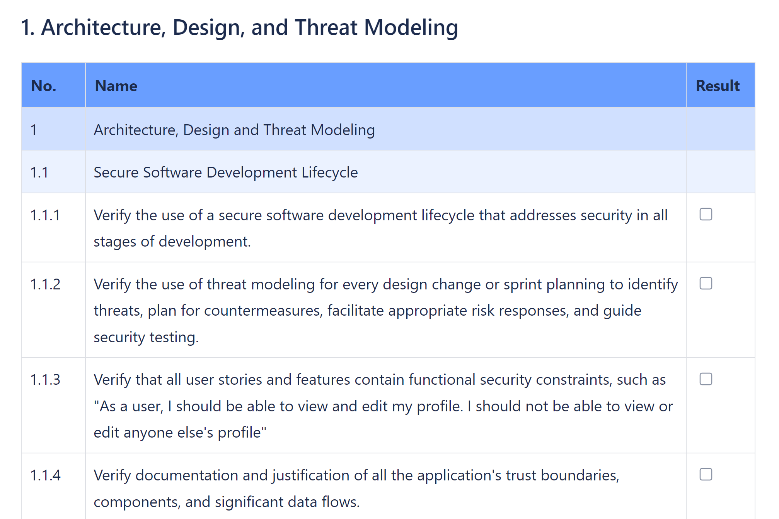
ASVS as a security blueprint

Slide 37
ASVS as a security blueprint
Create three checklists, each per level
The checklists doesn’t include the previous level items.
A Level 2 project will need the Level 1 checklist.
A Level 3 project will need Level 2 and Level 1 checklists.
This way the projects can add the checklists they need
A Level 2 project can be tested against Level 1 and Level 2 separately if needed.
Reporting will be easier using separate checklists

Slide 38
ASVS as a security blueprint
You will find a markdown version of three checklists in the repository of this workshop
Use this markdown for the next hands-on parts of the workshop or put it into a format that fits your team best.

Slide 39
Exercise #1
20 Minutes
Use the checklists in the workshop repository to create checklists for your group
Present the checklist to the other groups

Slide 40
Threat Model
Risk Analysis

Slide 41
Threat Model
A threat model is basically a risk analysis that describes possible threats of the solution
The model could be a drawing based on a high-level architecture drawing where you add possible risks like:
APIs, any kind of connectivity you cannot control
Third party software you don’t own
Infrastructure you can’t control
Also document the risks in detail, including an executive summary

Slide 42
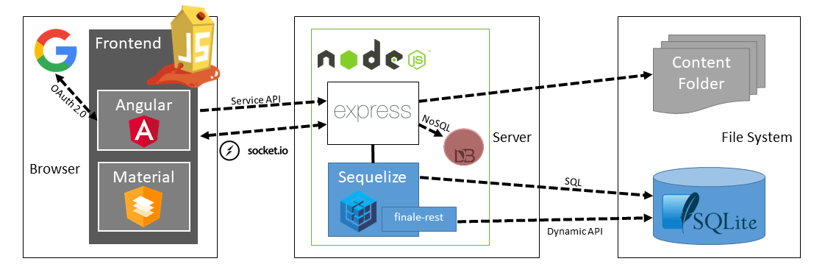
Juice Shop Architecture

Slide 43
Threat Model
The model should include
Detaillerd documentation of the risks
Documentation that all stakeholder accept possible risks, if so
The model should include the classification of the data and the customer
This classification defines the security level you develop against
The discussion about the threat model should include all stakeholders even the customer who should know all the risks.

Slide 44
Exercise #2
30 Minutes
Create a threat model of the Juice Shop
Document decisions
Present the threat model to the stakeholders

Slide 45
Penetration Tests

Slide 46
Penetration Tests
Testing a software against a security standard to find known vulnerabilities.
ASVS is one of the standards you can use to test against.
Use the checklists you created before to test one item after another
Focus on the risks identified with the threat model

Slide 47
Penetration Tests
Use the checklists to track what you just tested and what to test.
With the findings, you should write down the steps to reproduce and the tools you used to test specific items
Track number of findings compared to the number of items to test
This helps comparing with the retest
As best, track per chapter

Slide 48
Exercise #3
45 Minutes
Perform a pentest using the ASVS check list against the JuiceShop
Use the ASVS level you defined in the Threat Model
Write down the findings including the checklist numbers.
Present the pentest report to the stakeholders

Slide 49
Triage the findings

Slide 50
Triage and prioritize
Usually, triage will be done by the software engineering team, project management, the customer and – if available – an AppSec responsible Person
Some of the findings might be less risky than others
Look at the OWAS top 10

Slide 51
Triage and prioritize
Try to triage the findings base on the risk
Use the threat model to evaluate the risks
Triage also based on effort and budget
Given the fact you only have four developers and 10 days to fix the findings

Slide 52
Exercise #4
20 Minutes
Create an ordered backlog of the findings based on the triage
Present the backlog to the stakeholders

Slide 53
Fixing pentest findings

Slide 54
Fixing pentest findings
Software Engineers can now start fixing the findings bases on the priority of the backlog.
Software engineers should work closely together with the pentesters to find the right solution.
It makes sense to use the same tools the pentesters to prove the solutions.

Slide 55
Exercise #5
30 Minutes
Describe how you would solve the top 10 findings of your backlog.
Present the solutions to the stake holders

Slide 56
Retesting the application

Slide 57
Retesting the application
As soon the fixes are ready to deploy, a retest is needed.
Retests can be done after every fix or if all fixes are done
Retests usually test the findings not the entire application
Retests results need to be added to the pentest report

Slide 58
Exercise #6
20 Minutes
Retesting the Juice Shop based on the findings
Document if the retest is successful or not
(results needed later)

Slide 59
Pentest reports

Slide 60
Pentest reports
A pentest needs a report that you can hand over to the stake holders
Including an executive summary
It includes a detailed description on how you tested, what approach and on what environment
It also includes the scope of the Pentests
Describe what you didn’t test and why.

Slide 61
Pentest reports
A pentest includes a description of all the findings, how and where you found it and how to resolve.
Also the state after the retest
It includes an overall rating of the application before and after the retest.

Slide 62
Exercise #7
40 Minutes
Create a draft of a pentest report as described before
Present the outline and completeness to the stake holder

Slide 63
Workshop Questions and Answers

Slide 64
General Questions and Answers

Slide 65
THANK YOU 🤩
Feedback survey and certificate will be sent by email. Please fill in the survey 🙏🏼. Hope to see you again soon!

